Slide 1
LinkedIn Templates
1920x1080px
To export as images:
File > Export > Select file type as JPG > ensure the width and height are 1920px x 1080px and then Save
All pages use Roboto (preferred font).
Download and install from here: https://fonts.google.com/specimen/Roboto

Slide 2
We will be Exhibiting at the
Conference & Exhibition
May 31 - June 1, Houston
We hope to see you there!
www.lngexport.us

Slide 3
We are proud to be “Insert sponsor level” at the
Conference & Exhibition
May 31 - June 1, Houston
We hope to see you there!
www.lngexport.us

Slide 4
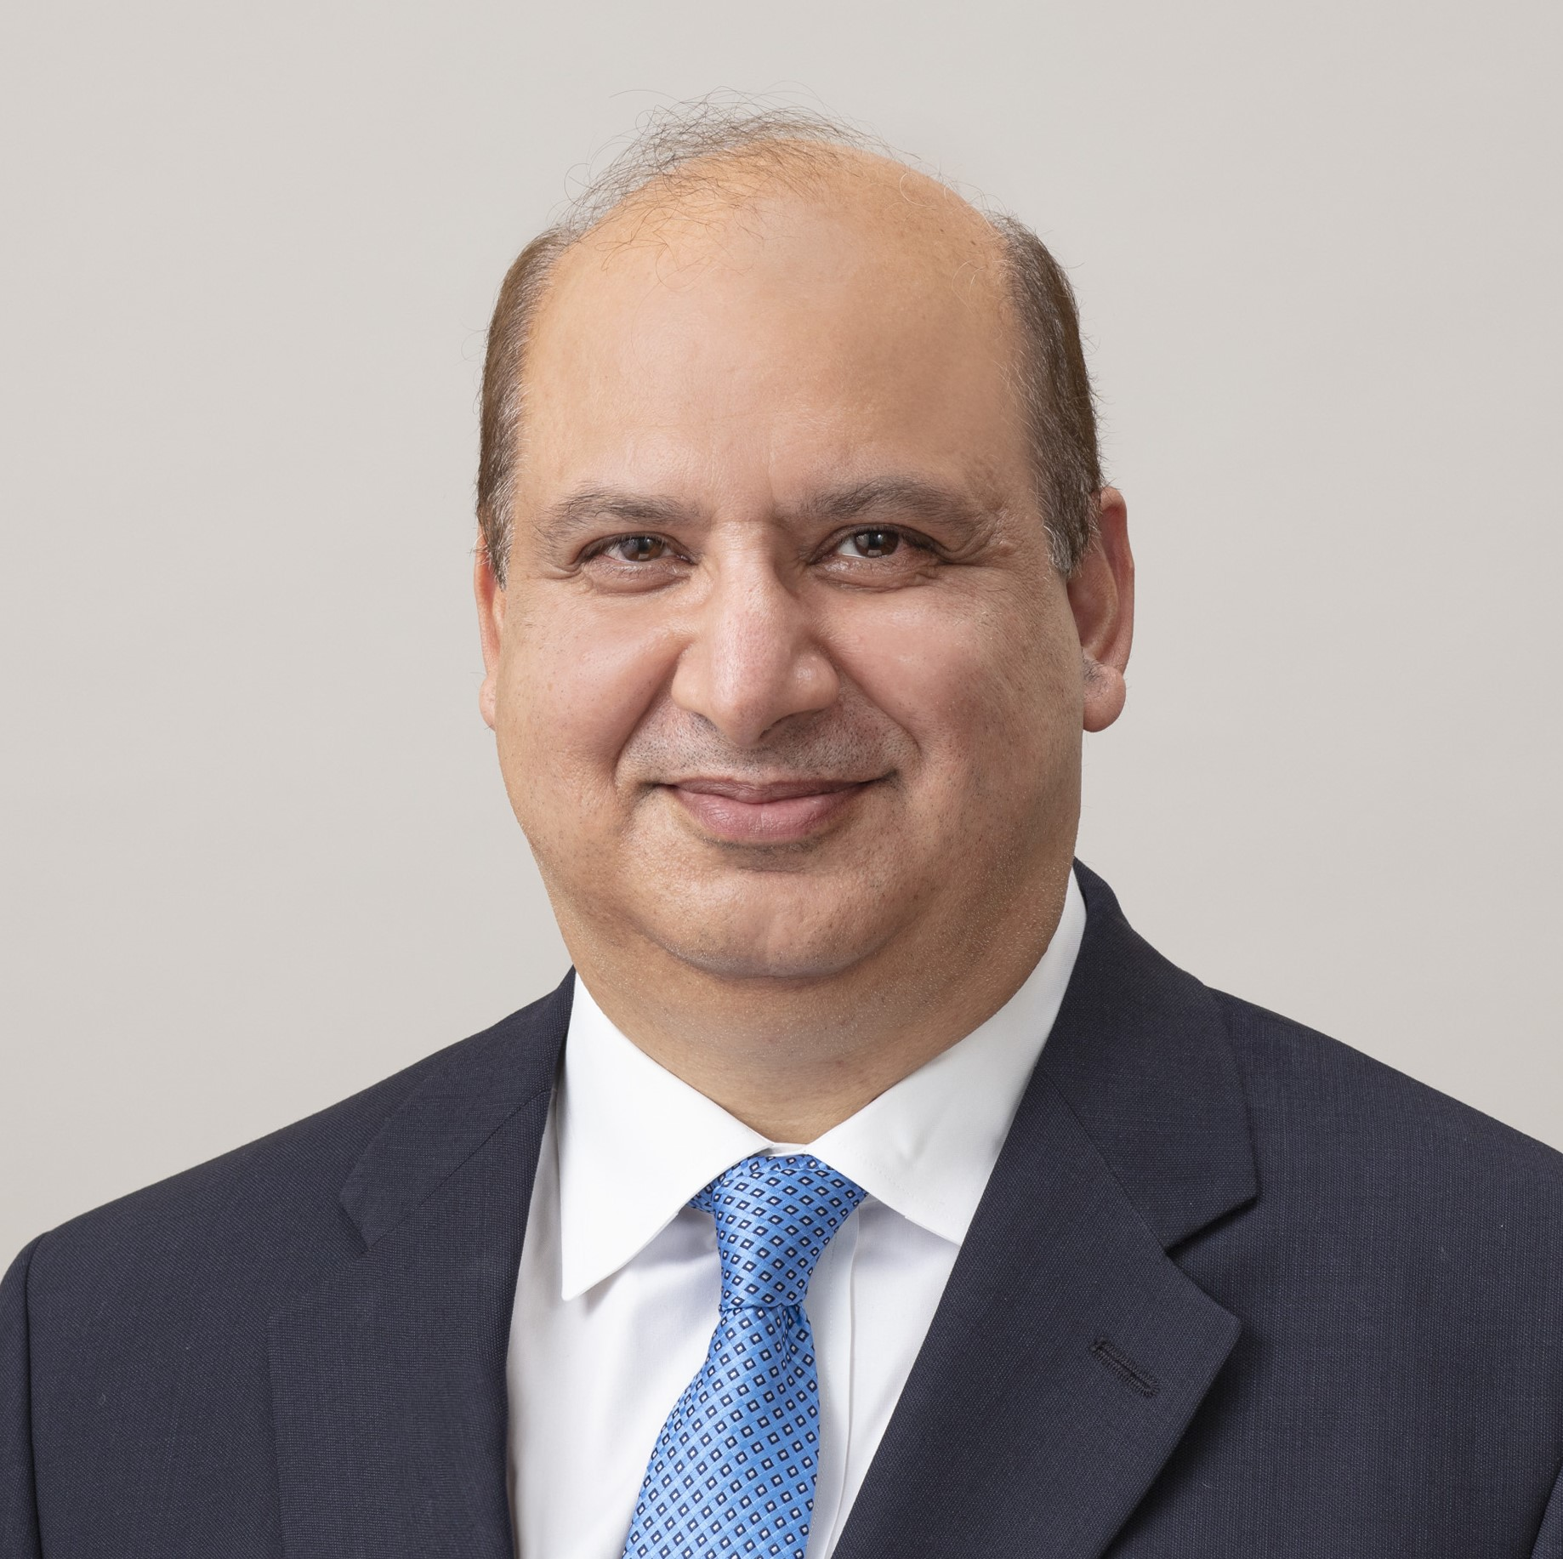
<company name> will be speaking at the LNG Export Engineering & Construction Conference (May 31 – June 1, Houston).
<speaker name, title> will be discussing <sessions title and overview>
We hope to see you there!
Farhan Mujib
President, JGC Corporation
www.LNGEXPORT.US

